Slide 1


Web Host Comparison
Which to pick!

Slide 2
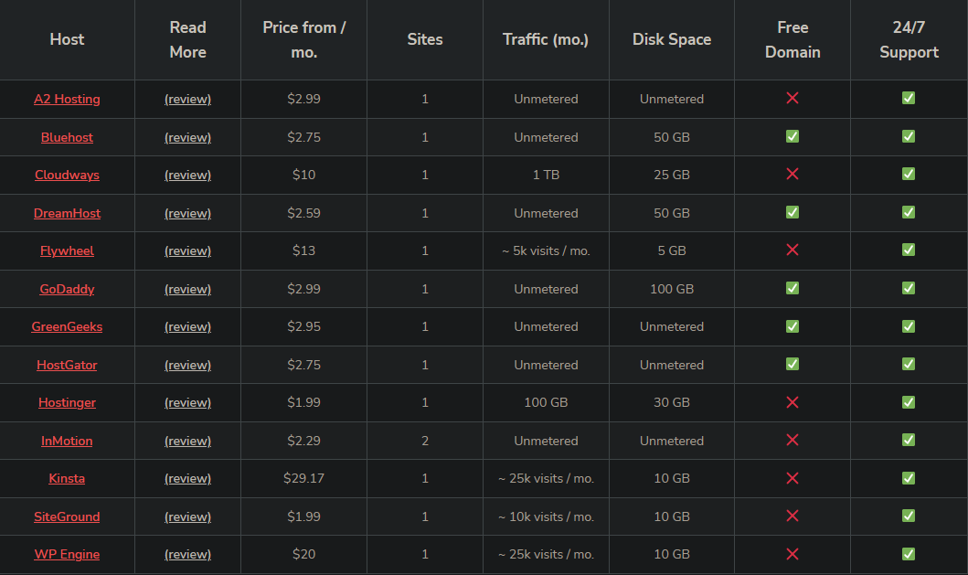
A chart comparing prices (not NZD) (not mine)
https://www.codeinwp.com/blog/web-hosting-comparison-chart/
This was a super useful chart I found online. I highlighted the ones I am looking at comparing in the next slides.

Slide 3
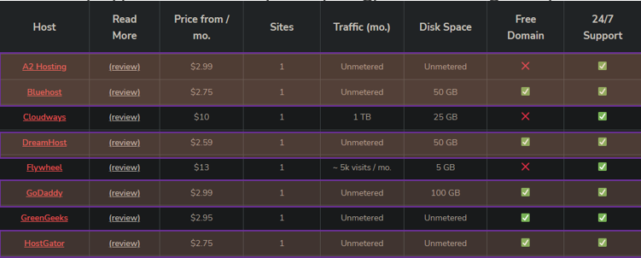
Talk about the differences
https://www.forbes.com/advisor/business/software/best-web-hosting-services/
Another useful site I found

Slide 4



IN the red corner!
Very affordable
Very good support
Free domain and SSL certificate
Prices can increase and upsells
The cheapest option doesn’t have
custom domain
dreamhost

Slide 5

In the blue corner
Very easy to use
Pricing doesn’t change
Varied pricing options
Has less extra features than some
other brands
GODADDY

Slide 6

In the green corner
Unlimited and unmetered
traffic and disk space
Free domain
Automated backups
Little bit more expensive
A2 Hosting

Slide 7

BlueHost
Has 100% upkeep according
to the site before
Free domain for first year at no extra cost
Must pay for automated backups
Prices increase on renewal
In the purple corner!

Slide 8

In the yello corner
All plans give unmetered disk space
Free website transfer
Free domain and SSL
$100 google ad credit?
Pricing is for 3 years
Automated backups cost lil extra
Host Gator

Slide 9
By Bradley Dunlop
Chief Network Engineer of DevOps @ Mahomies

